Slide 1
Show, Attend and Tell : Neural Image Caption Generation with Visual Attention

Slide 2
Neural Image Caption Generation with Visual Attention
An attention based model that automatically learns to describe the content of images.
We describe how we can train this model in a deterministic manner using standard backpropagation techniques and stochastically by maximizing a variational lower bound.
Automatically generating captions of an image is a task very close to the heart of scene understanding—one of the primary goals of computer vision.
Rather than compress an entire image into a static representation, attention allows for salient features to dynamically come to the forefront as needed. This is especially important when there is a lot of clutter in an image.

Slide 3
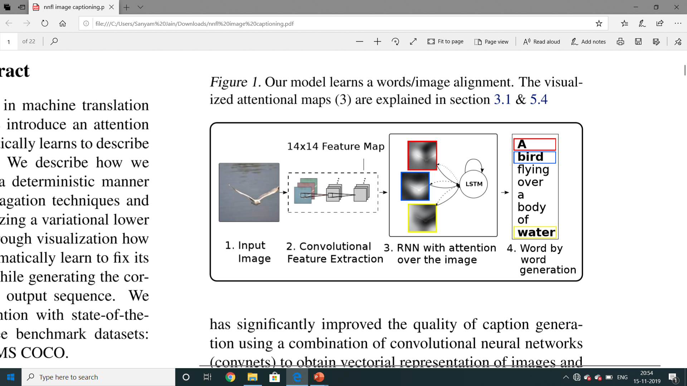
Architecture
Our model takes a single raw image and generates a caption y encoded as a sequence of 1-of-K encoded words.
y = {y1,...,yC}, yi ∈RK where K is the size of the vocabulary and C is the length of the caption.

Slide 4
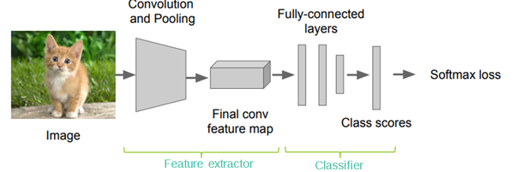
Encoder Architecture

Slide 5
Encoder
We use a convolutional neural network in order to extract a set of feature vectors which we refer to as annotation vectors.
The extractor produces L vectors, each of which is a D-dimensional representation corresponding to a part of the image. a = {a1,...,aL}, ai ∈Rd in order to obtain a correspondence between the feature vectors and portions of the 2-D image, we extract features from a lower convolutional layer.
This allows the decoder to selectively focus on certain parts of an image by selecting a subset of all the feature vectors.

Slide 6
The two variants of our attention-based model
Soft attention:
Compute a weighted combination (attention) over some inputs using an attention network.
Can use backpropagation to train end-to-end.
Hard attention:
Attend to a single input location.
Can’t use gradient descent.
Need reinforcement learning.

Slide 7
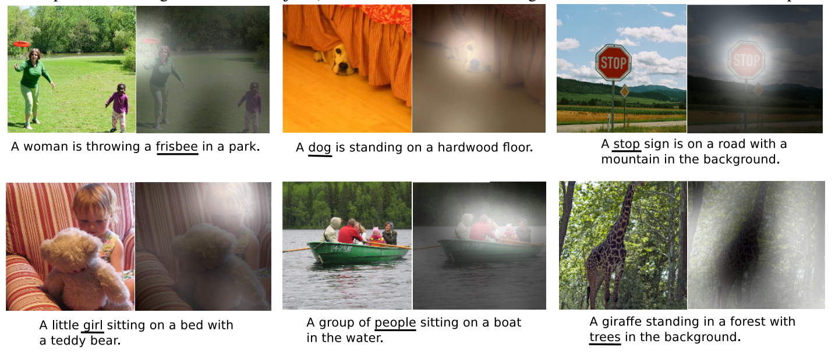
Examples of attending to the correct object (white indicates the attended regions, underlines indicated the corresponding word)

Slide 8
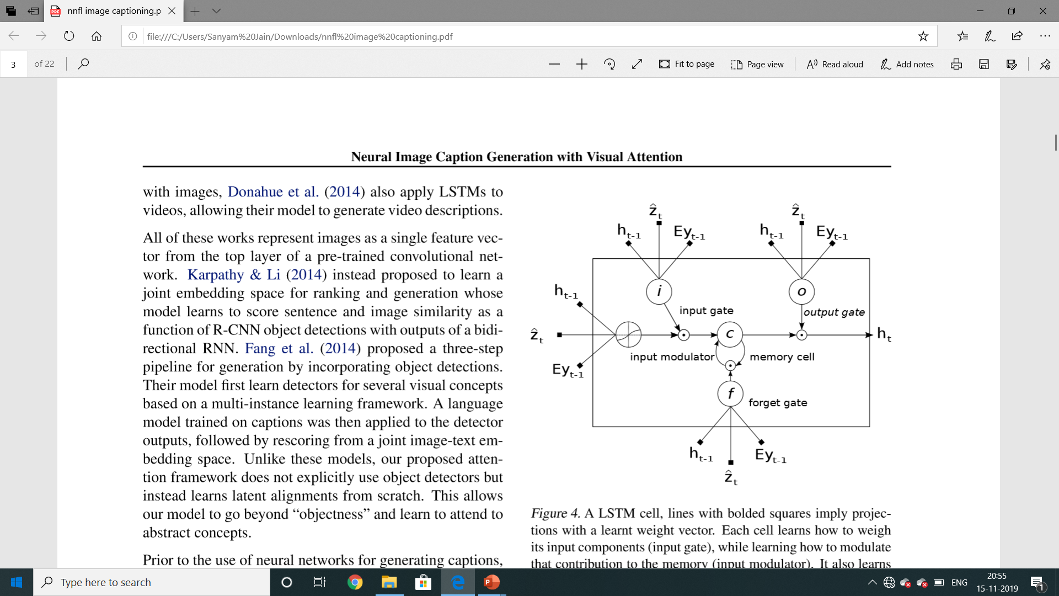
Decoder
We use a long short-term memory (LSTM) network (Hochreiter & Schmidhuber, 1997) that produces a caption by generating one word at every time step conditioned on a context vector, the previous hidden state and the previously generated words.

Slide 9
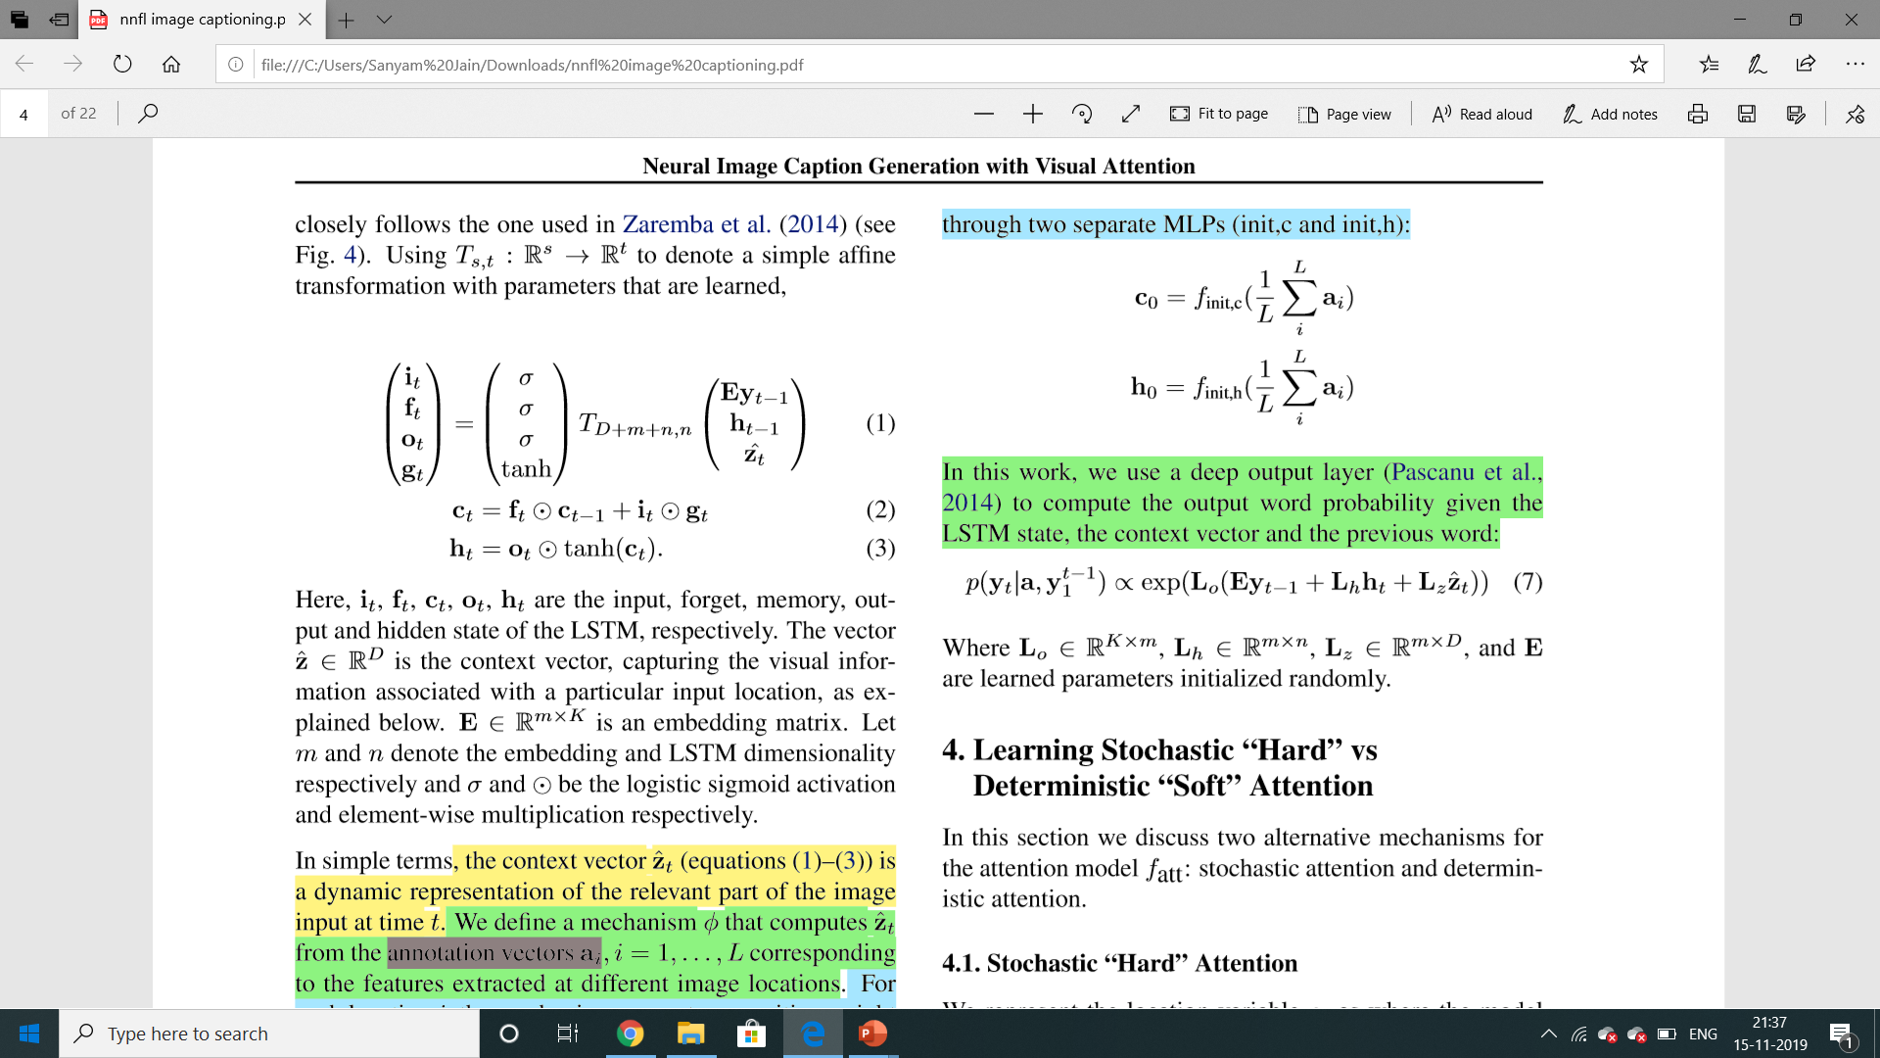
LSTM
Our implementation of LSTM Using Ts, t : Rs → Rt to denote a simple afﬁne transformation with parameters that are learned,
Here, i, f, c, o, h are the input, forget, memory, output and hidden state of the LSTM, respectively.
The vector z ∈ Rd is the context vector, E is an embedding matrix and σ is the logistic sigmoid activation.
Context vector captures the visual information associated with a particular input location.

Slide 10
LSTM
The context vector z is a dynamic representation of the relevant part of the image input.
We deﬁne a mechanism φ that computes z from the annotation vectors. For each location i, the mechanism generates a positive weight α which can be interpreted either as the probability that location i is the right place to focus for producing the next word.
The weight α of each annotation vector a is computed by an attention model for which we use a multi layer perceptron conditioned on the previous hidden state.
The network looks next depends on the sequence of words that has already been generated.

Slide 11

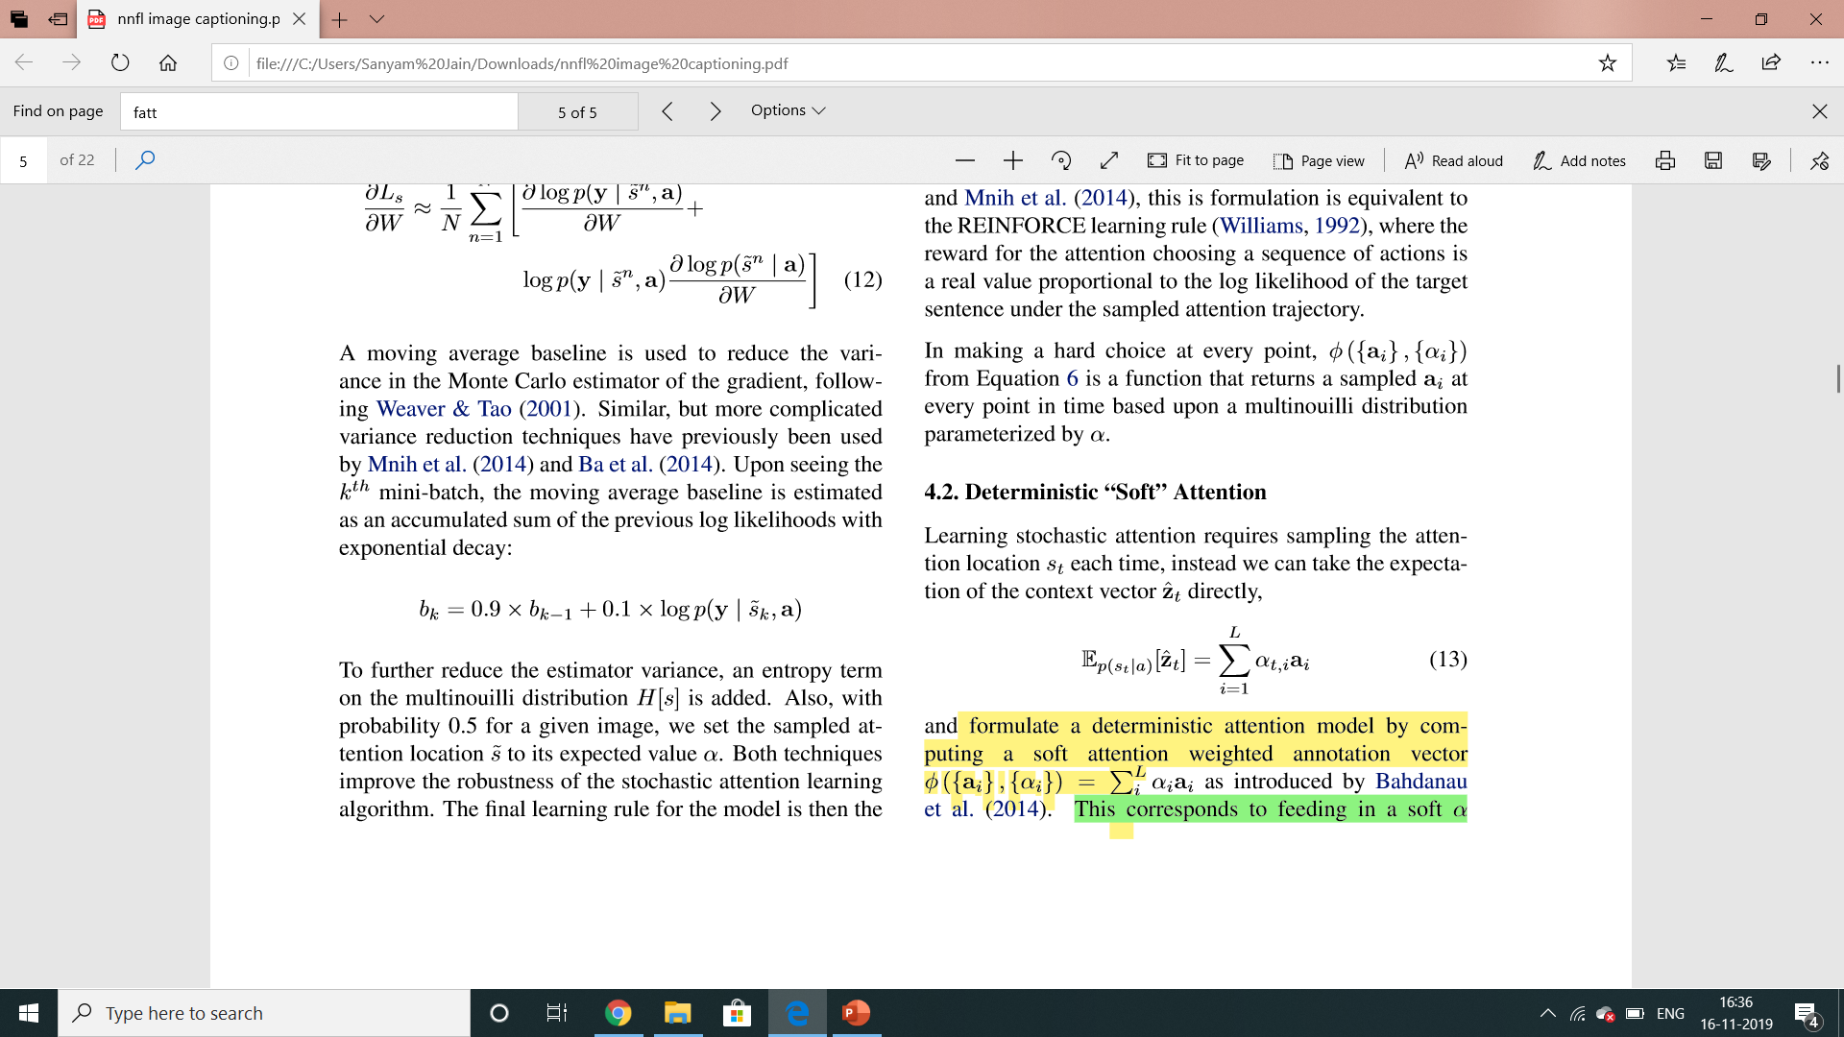
Soft Attention for Translation
eti =fatt(a,ht−1)
Mixture weights:
z = φ({a},{α})
where φ is a function that returns a single vector given the set of annotation vectors and their corresponding weights.
Context vector (input to decoder): z

Slide 12
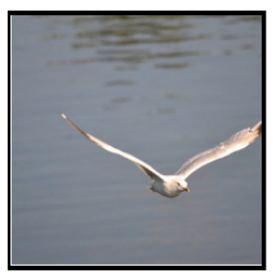
RNN Architecture
Distribution over L locations
Distribution over vocab
a1
a2
d1
a3
d2
CNN
h0
h1
h2
Features: L x D
Image: H x W x 3
Weighted features: D
z1
y1
z2
y2
Weighted combination of features
First word

Slide 13
Soft attention:
Summarize ALL locations z = p_{a}a+ p_{b}b + p_{c}c + p_{d}d
Derivative dz/dp is nice!
Train with gradient descent
a | b
c | d
CNN
Grid of features
(Each D-dimensional)
Image: H x W x 3
Context vector z (D-dimensional)
p_{a} | p_{b}
p_{c} | p_{d}
From RNN:
Distribution over grid locations p_{a} + p_{b} + p_{c} + p_{c} = 1

Slide 14
Attention Takeaways
Performance:
Attention models can improve accuracy and reduce computation at the same time.
Complexity:
There are many design choices.
Those choices have a big effect on performance.
Ensembling has unusually large benefits.
Simplify where possible!

Slide 15
Attention Takeaways
Explainability:
Attention models encode explanations.
Both locus and trajectory help understand what’s going on.
Hard vs. Soft:
Soft models are easier to train, hard models require reinforcement learning.
They can be combined, as in Luong et al.

Slide 16
Training Procedure
Both variants of our attention model were trained with stochastic gradient descent using adaptive learning rate algorithms.
For the Flickr8k dataset, we found that RMSProp (Tieleman & Hinton, 2012) worked best.
To create the annotations used by our decoder, we used the Oxford VGG (19) (Simonyan & Zisserman, 2014) and ResNet (resnet152).
We use the 14×14×512 feature map of the fourth convolutional layer before max pooling. This means our decoder operates on the ﬂattened 196 × 512 (i.e. L × D) encoding.
The only other regularization strategy we used was early stopping on BLEU score. We observed a breakdown in correlation between the validation set log-likelihood and BLEU in the later stages of training during our experiments. Since BLEU is the most commonly reported metric, we used BLEU on our validation set for model selection.

Slide 17
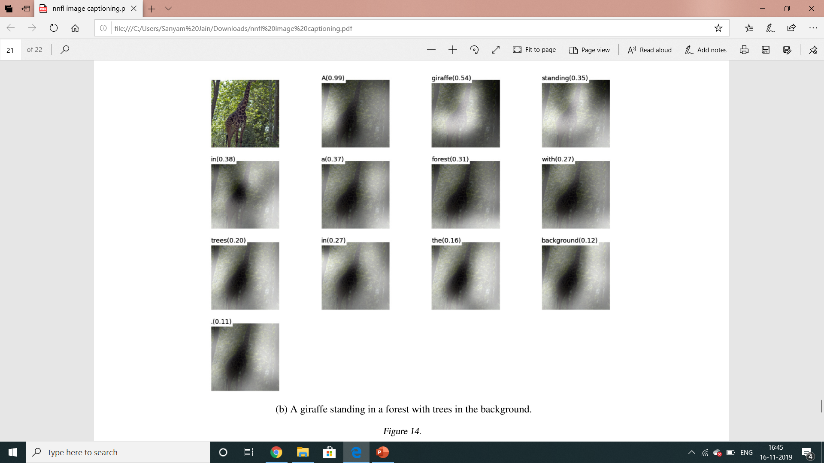
Example

Slide 18
Results

Slide 20
Thank You
Deepak Jain 2017B5A30935P
Sanyam Jain 2017A7PS0014P
Soham Agarwal 2017A3PS0345P
References:
Paper: https://arxiv.org/abs/1502.03044
PyTorch : https://pytorch.org/docs/stable/index.html

